Slide 1
COT5615: Math for Intelligent Systems I
Anand Rangarajan
Lecture 7

Slide 2
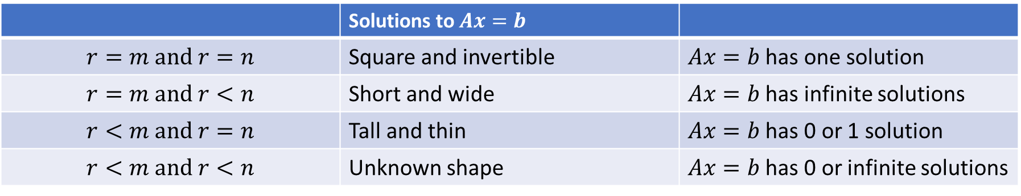


Solutions to $Ax=b$
Full column rank $r=n$ means one solution or none
Full row rank $r=m$ means one solution if $m=n$ or infinitely many if $m<n$
Four possibilities:
 | Square and invertible
 | Short and wide
 | Tall and thin
 | Unknown shape

Slide 3
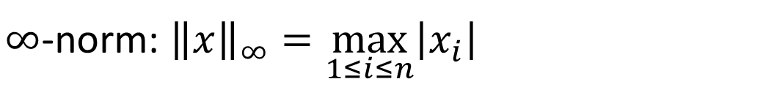
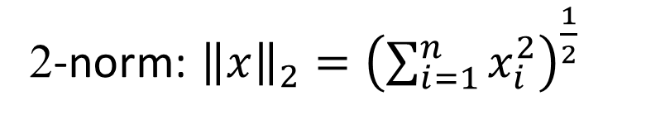
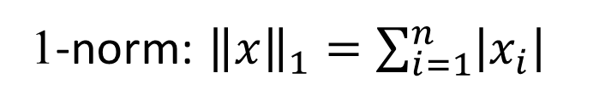

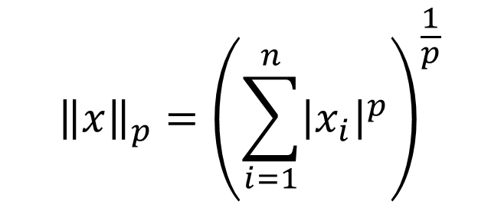
Existence, Uniqueness, and Conditioning
Solving Linear Systems Special Types of Linear Systems Software for Linear Systems
Singularity and Nonsingularity Norms
Condition Number Error Bounds
Vector Norms
Magnitude, modulus, or absolute value for scalars generalizes to norm for vectors
We will use only p-norms, defined by
$${\left\|x\right\|}_{p}={\left(\sum_{i=1}^{n}{{\left|x_{i}\right|}^{p}}\right)}^{\frac{1}{p}}$$
for integer p > 0 and n-vector $x$
Important special cases
1-norm: ${\left\|x\right\|}_{1}=\sum_{i=1}^{n}{\left|x_{i}\right|}$
2-norm: ${\left\|x\right\|}_{2}={\left(\sum_{i=1}^{n}{x_{i}^{2}}\right)}^{\frac{1}{2}}$
$∞$-norm: ${\left\|x\right\|}_{∞}=\max_{1≤i≤n}\left|x_{i}\right|$

Slide 4
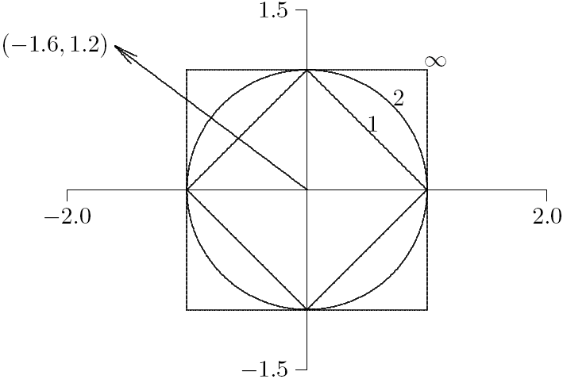
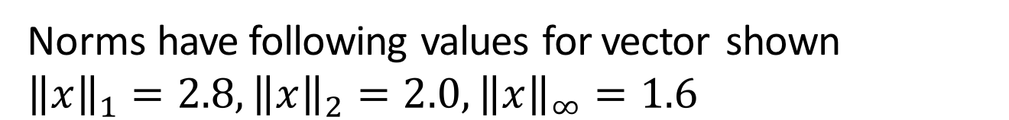
Existence, Uniqueness, and Conditioning
Solving Linear Systems Special Types of Linear Systems Software for Linear Systems
Singularity and Nonsingularity Norms
Condition Number Error Bounds
Example: Vector Norms
Drawing shows unit sphere in two dimensions for each norm
Norms have following values for vector shown
$${\left\|x\right\|}_{1}=2.8, {\left\|x\right\|}_{2}=2.0,{\left\|x\right\|}_{∞}=1.6$$

Slide 5
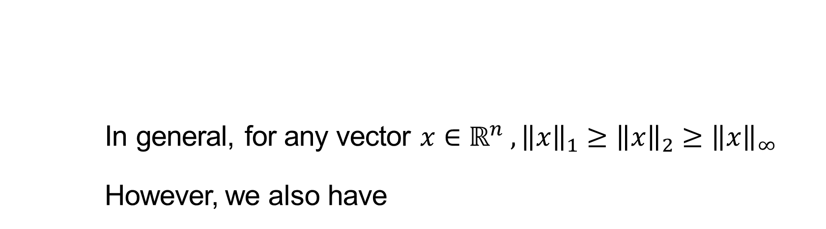
Existence, Uniqueness, and Conditioning
Solving Linear Systems Special Types of Linear Systems Software for Linear Systems
Singularity and Nonsingularity Norms
Condition Number Error Bounds
Equivalence of Norms
In general, for any vector $x∈ℝ^{n} , {\left\|x\right\|}_{1}≥{\left\|x\right\|}_{2}≥{\left\|x\right\|}_{∞}$
However, we also have
$${\left\|x\right\|}_{1}≤\sqrt{n}{\left\|x\right\|}_{2}, {\left\|x\right\|}_{2}≤\sqrt{n}{\left\|x\right\|}_{∞}, and {\left\|x\right\|}_{1}≤n{\left\|x\right\|}_{∞}$$
Thus, for given n, norms differ by at most a constant, and hence are equivalent: if one is small, they must all be proportionally small.
Notes:
Proof of the first equation

Slide 6
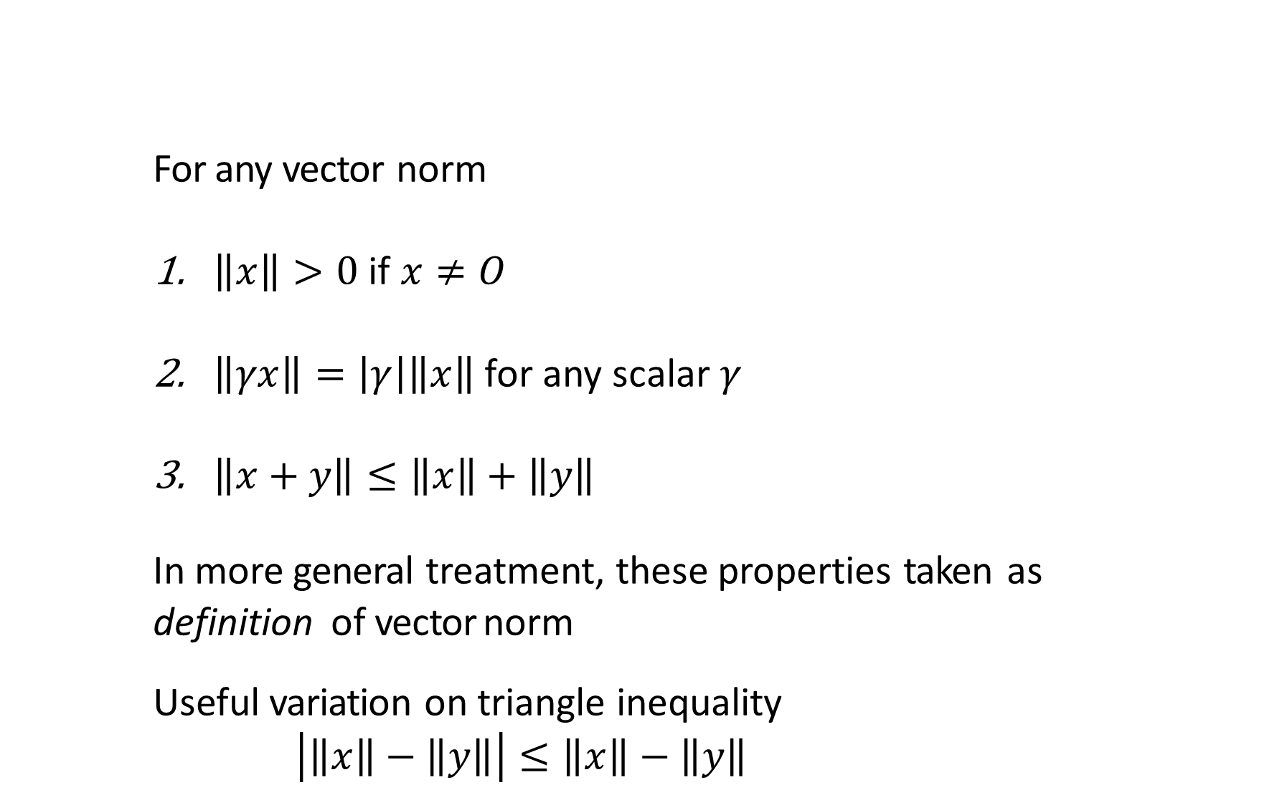
Existence, Uniqueness, and Conditioning
Solving Linear Systems Special Types of Linear Systems Software for Linear Systems
Singularity and Nonsingularity Norms
Condition Number Error Bounds
Properties of Vector Norms
For any vector norm
$\left\|x\right\|>0$ if $x≠O$
$\left\|γx\right\|=\left|γ\right|\left\|x\right\|$ for any scalar $γ$
$\left\|x+y\right\|≤\left\|x\right\|+\left\|y\right\|$
In more general treatment, these properties taken as
definition of vector norm
Useful variation on triangle inequality
$$\left|\left\|x\right\|−\left\|y\right\|\right|≤\left\|x\right\|−\left\|y\right\|$$

Slide 7
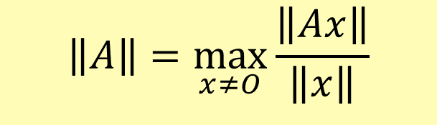
Existence, Uniqueness, and Conditioning
Solving Linear Systems Special Types of Linear Systems Software for Linear Systems
Singularity and Nonsingularity Norms
Condition Number Error Bounds
Matrix Norms
Matrix norm corresponding to given vector norm is defined by
$$\left\|A\right\|=\max_{x≠O}{\frac{\left\|Ax\right\|}{\left\|x\right\|}}$$
Norm of matrix measures maximum stretching matrix does to any vector in given vector norm

Slide 8
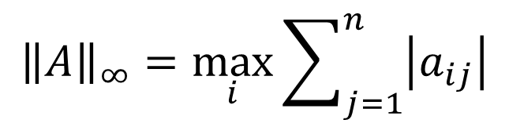
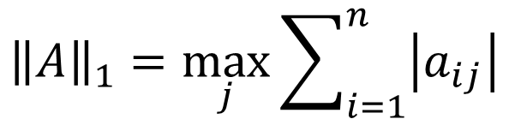
Existence, Uniqueness, and Conditioning
Solving Linear Systems Special Types of Linear Systems Software for Linear Systems
Singularity and Nonsingularity Norms
Condition Number Error Bounds
Matrix Norms
Matrix norm corresponding to vector 1-norm is maximum absolute column sum
$${\left\|A\right\|}_{1}=\max_{j}{\sum_{i=1}^{n}{\left|a_{ij}\right|}}$$
Matrix norm corresponding to vector ∞-norm is maximum
absolute row sum
$${\left\|A\right\|}_{∞}=\max_{i}{\sum_{j=1}^{n}{\left|a_{ij}\right|}}$$
Handy way to remember these is that matrix norms agree with corresponding vector norms for n × 1 matrix

Slide 9
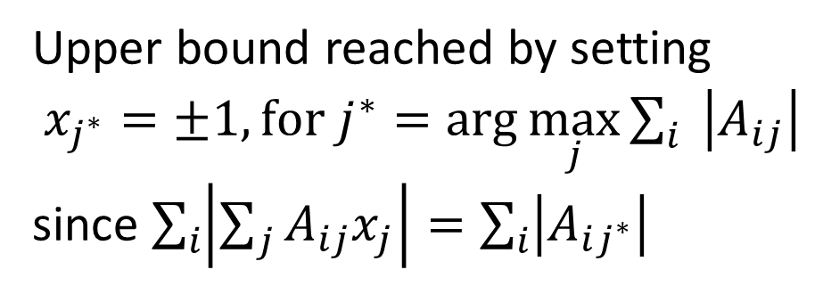
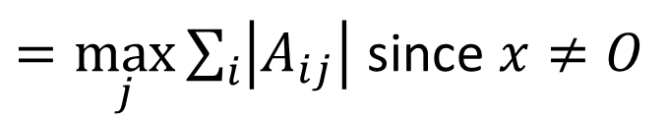
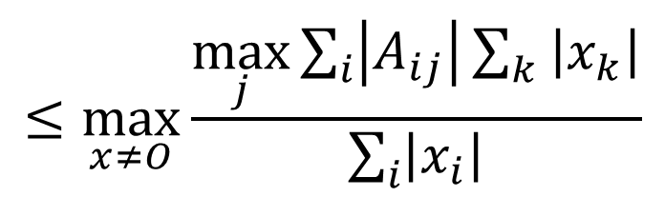
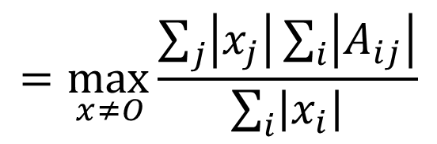
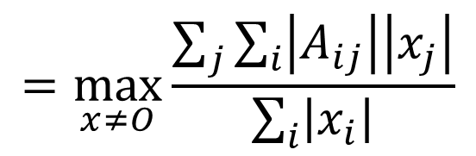
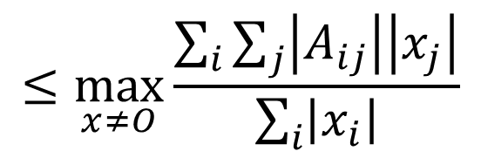
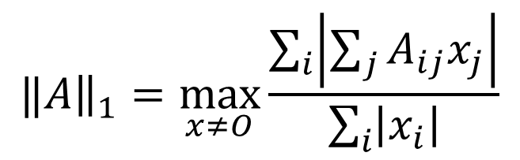

Proof of Matrix $L_{1}$ norm
$$‖A{\left.​\right\|}_{1}=\max_{x≠O}\frac{\sum_{i}{\left|\sum_{j}{A_{ij}x_{j}}\right|}}{\sum_{i}{\left|x_{i}\right|}}$$
$$≤\max_{x≠O}{\frac{\max_{j}{\sum_{i}{\left|A_{ij}\right|\sum_{k}{\left|x_{k}\right|}}}}{\sum_{i}{\left|x_{i}\right|}}}$$
$$≤\max_{x≠O}{\frac{\sum_{i}{\sum_{j}{\left|A_{ij}\right|\left|x_{j}\right|}}}{\sum_{i}{\left|x_{i}\right|}}}$$
$=\max_{j}{\sum_{i}{\left|A_{ij}\right|}}$ since $x≠O$
$$=\max_{x≠O}{\frac{\sum_{j}{\sum_{i}{\left|A_{ij}\right|\left|x_{j}\right|}}}{\sum_{i}{\left|x_{i}\right|}}}$$
$$\underset{ x≠O}{=max}{\frac{\sum_{j}{\left|x_{j}\right|\sum_{i}{\left|A_{ij}\right|}}}{\sum_{i}{\left|x_{i}\right|}}}$$
Upper bound reached by setting
$x_{j^{∗}}=±1, for j^{∗}=\arg{\max_{j}{\sum_{i}{\left|A_{ij}\right|}}}$
since $\sum_{i}{\left|\sum_{j}{A_{ij}x_{j}}\right|=\sum_{i}{\left|A_{ij^{∗}}\right|}}$

Slide 10
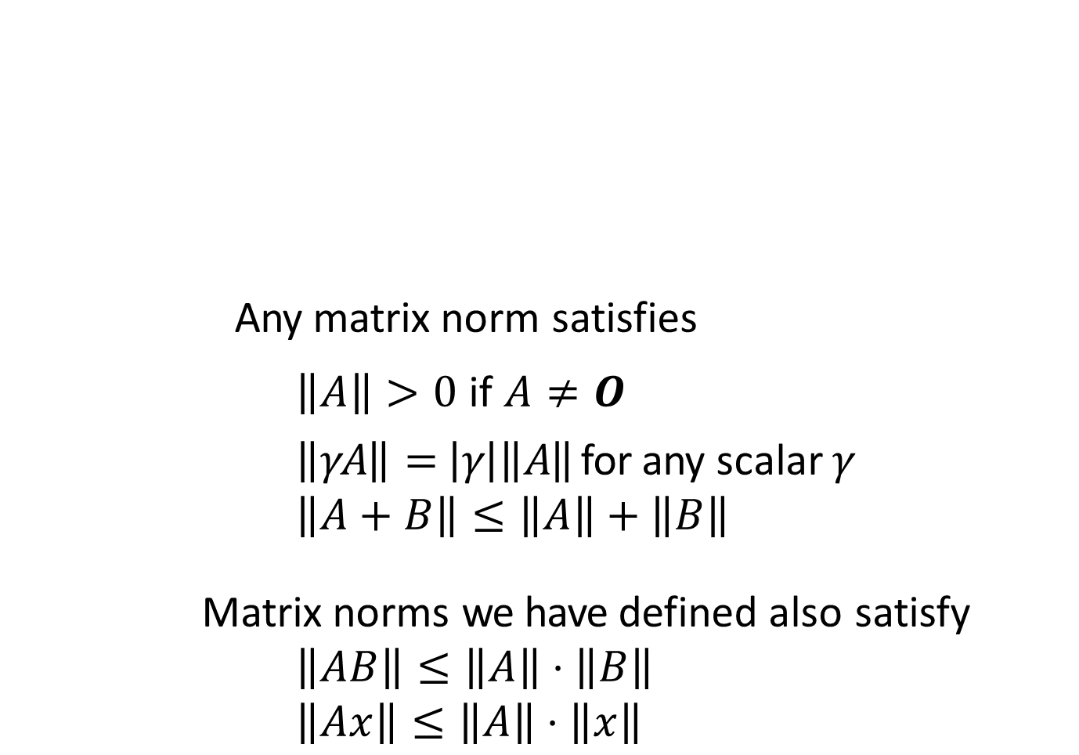
Existence, Uniqueness, and Conditioning
Solving Linear Systems Special Types of Linear Systems Software for Linear Systems
Singularity and Nonsingularity Norms
Condition Number Error Bounds
Properties of Matrix Norms
Any matrix norm satisfies
$\left\|A\right\|>0$ if $A≠O$
$\left\|γA\right\|=\left|γ\right|\left\|A\right\|$ for any scalar $γ$
$$\left\|A+B\right\|≤\left\|A\right\|+\left\|B\right\|$$
Matrix norms we have defined also satisfy
$$\left\|AB\right\|≤\left\|A\right\|⋅\left\|B\right\|$$
$$\left\|Ax\right\|≤\left\|A\right\|⋅\left\|x\right\|$$

